Slide 1




Afonso Bessa
PG53597
COVID-19'S INFLUENCE ON
GLOBAL SOCIO-ECONOMIC LANDSCAPE
Francisco Claudino
PG50380
Smart Analysis in Big Data Systems
13 / 06 / 2024

Slide 2

INDEX
01
02
03
04
Introduction
Definitions
State of Art
Data Breakdown
05
06
07
Methods
Results
Conclusion
Smart Analysis in Big Data Systems

Slide 3


INTRODUCTION
01
The COVID-19 pandemic drastically altered global life, causing widespread economic and social challenges.
02
Our study examines the impact of the pandemic on GDP, Inflation, Migration, Population, Taxes and Unemployment.
Research questions focus on the impact on a global scale, comparing G8 and non-G8 Countries, G8 versus G20 and conducting a Continental analysis on these factors.
03
Smart Analysis in Big Data Systems

Slide 4
DEFINITIONS
01
COVID-19
05
Population
02
06
Gross Domestic Product (GDP)
Taxes
03
Inflation
07
Unemployment
04
Migration
08
G8 and G20 Countries
Smart Analysis in Big Data Systems

Slide 5

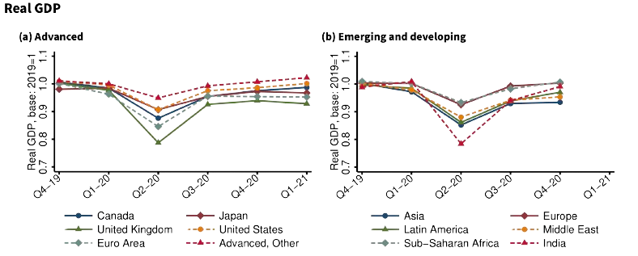
STATE OF THE ART
01
GDP decrease in the beginning of the Pandemic across all Continents and Countries
02
Boosted demand without corresponding production lead to the rise of the Inflation
03
Slow Migration rates
04
Slow Population growth
05
Unemployment spikes with gradual recovery
Smart Analysis in Big Data Systems

Slide 6

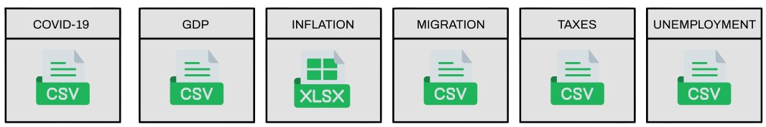
DATA BREAKDOWN
Dataset Files
Smart Analysis in Big Data Systems

Slide 7

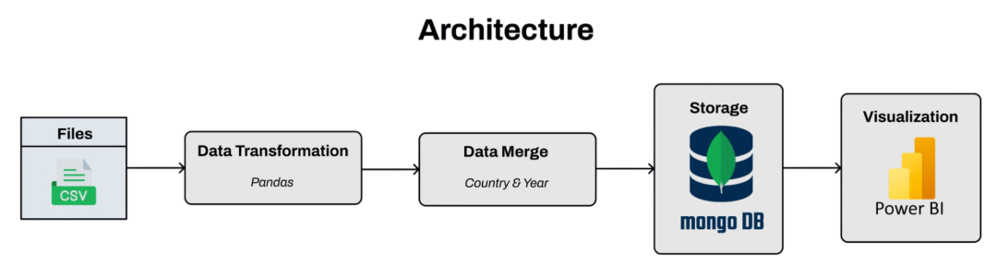
METHODS
01
Reshaping the Datasets based on the melt function
02
Merge process done by Country and Year
03
Apache Spark (14.7 secs) versus Pandas (1.3 secs)
Smart Analysis in Big Data Systems

Slide 8


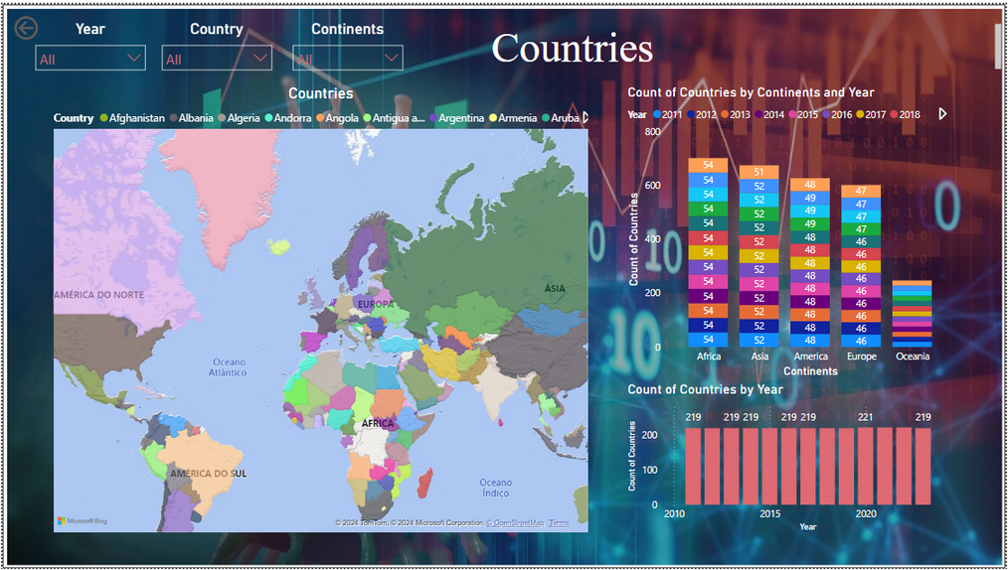
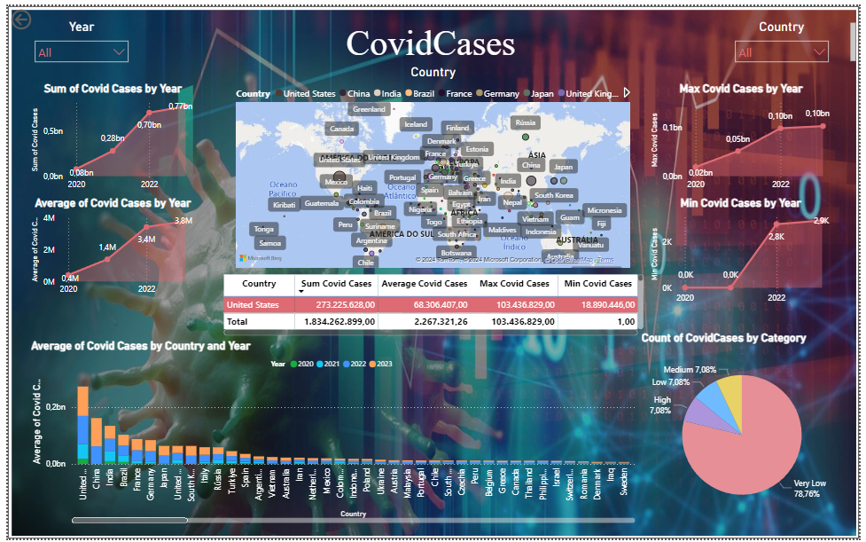
RESULTS
Globally
Smart Analysis in Big Data Systems

Slide 9
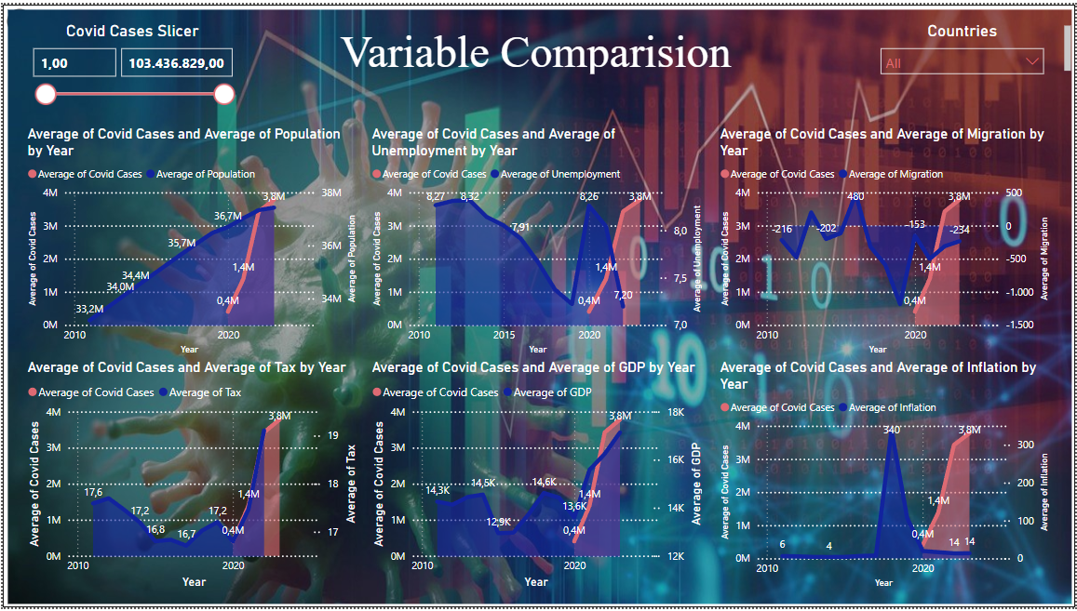
RESULTS
Globally
Smart Analysis in Big Data Systems

Slide 10
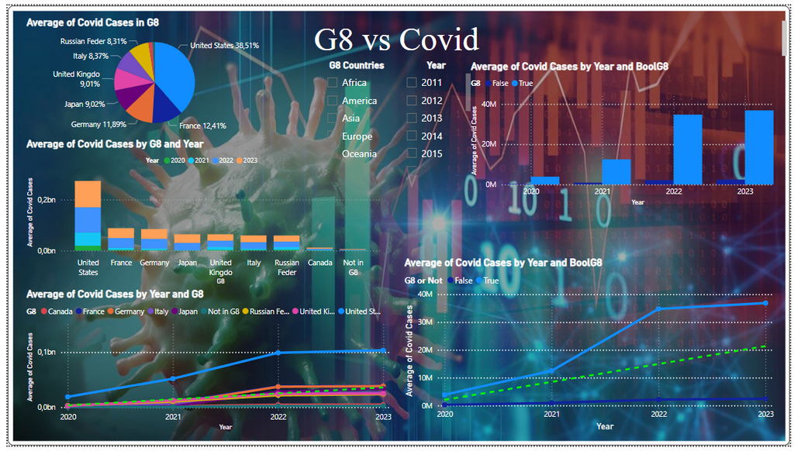
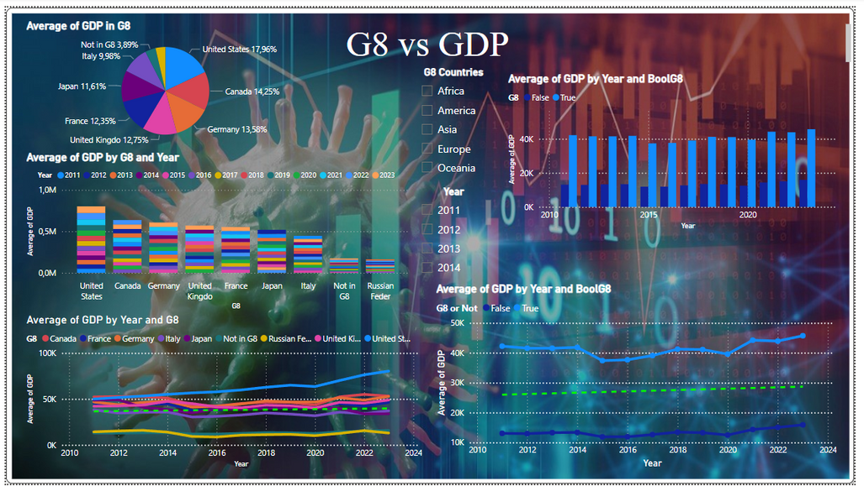
RESULTS
G8 Countries
Smart Analysis in Big Data Systems

Slide 11
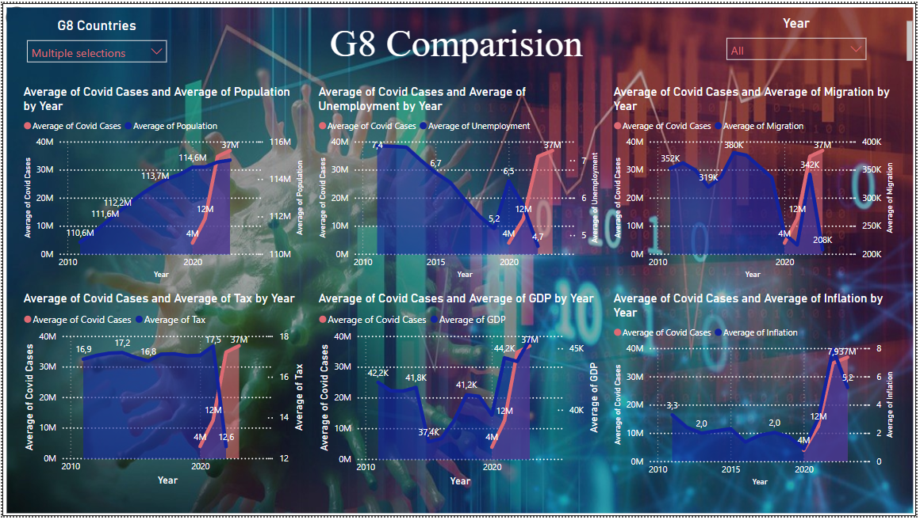
RESULTS
G8 Countries
Smart Analysis in Big Data Systems

Slide 12
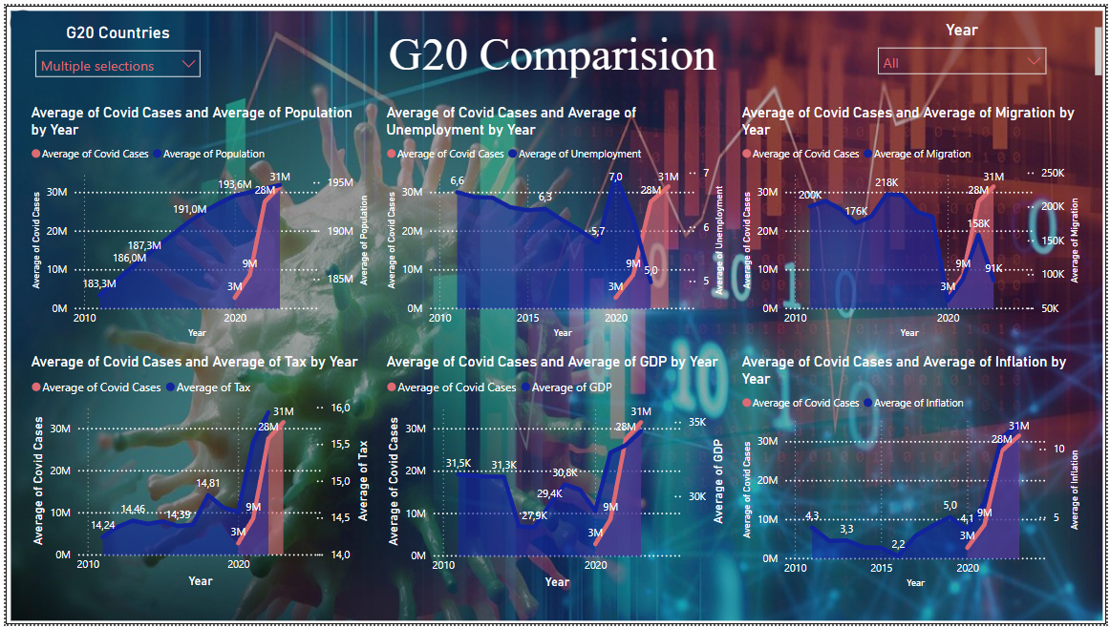
RESULTS
G20 Countries
Smart Analysis in Big Data Systems

Slide 13
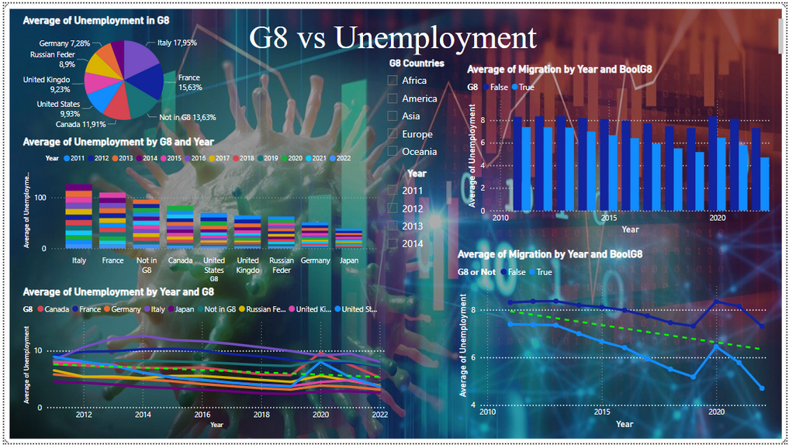
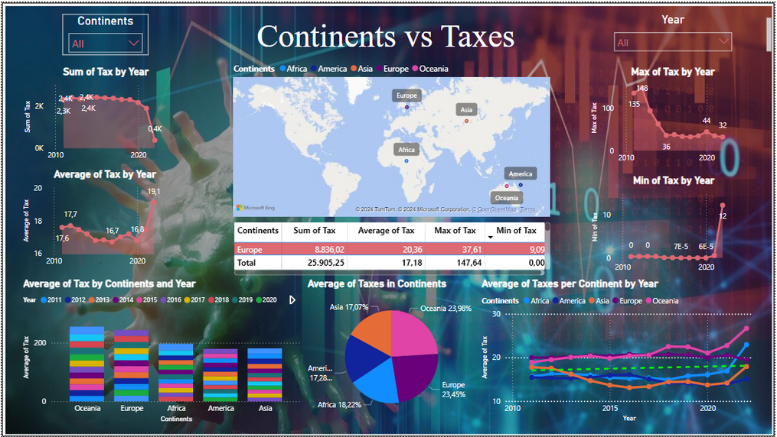
RESULTS
Continents
Smart Analysis in Big Data Systems

Slide 14
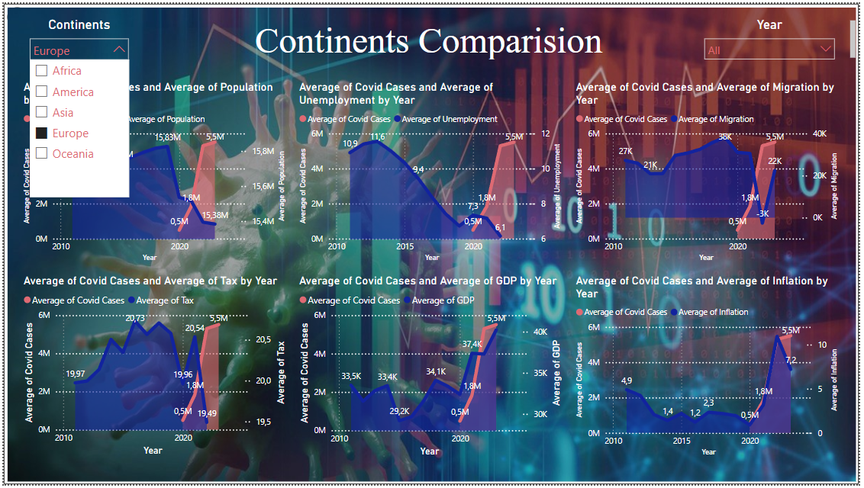
RESULTS
Continents
Smart Analysis in Big Data Systems

Slide 15


CONCLUSION
Disparities Between Developed and Developing Nations
Socio-Economic Changes and Long-Term Implications
Global Economic Impact and Recovery Dynamics
Employment, Income Inequality, and Poverty
Smart Analysis in Big Data Systems

Slide 16
Afonso Bessa
PG53597
COVID-19'S INFLUENCE ON
GLOBAL SOCIO-ECONOMIC LANDSCAPE
Francisco Claudino
PG50380
Smart Analysis in Big Data Systems
13 / 06 / 2024

